Slide 1
Airspace Change Proposal
Table One. These are principles that must be taken into account in the airspace design, and are included for your information.
Table Two. These are general principles that can be used to design the airspace. Please rank them in importance, and comment where possible.
Table Three. These principles are more detailed about noise and who should be flown over. Again, please rank them in order of importance.
Once you have completed the form, please email it:
NOR-Airspaceportal@mod.gov.uk
  Many thanks for taking the time to send us your views
Notes:
1

Slide 2
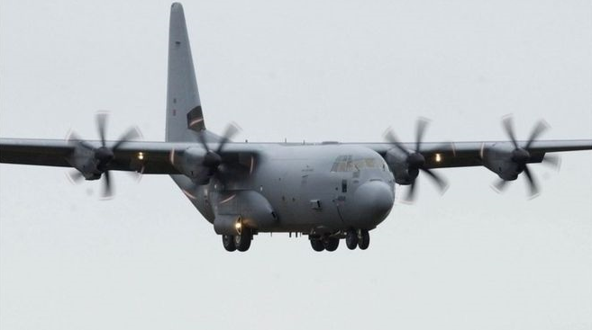
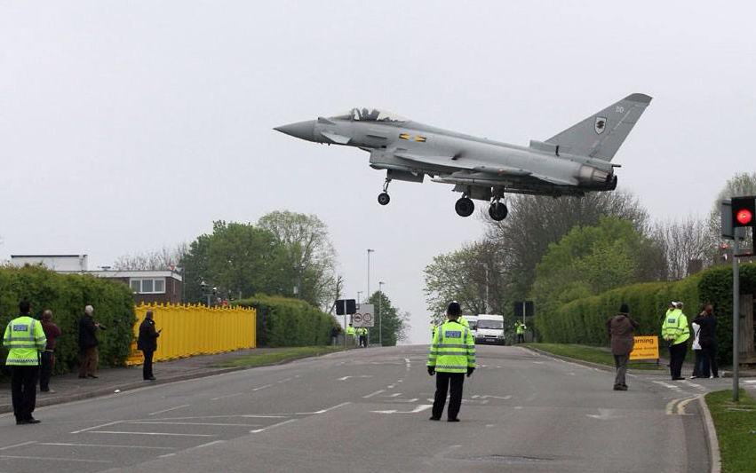
Table One
Must Be Safe
Provide a safely designed airspace structure and routes, to ensure the safe operation of aircraft
Must ensure continuation of military and governmental operational activity
RAF Northolt must be able to operate to its current commitments and future Defence requirements

Slide 3
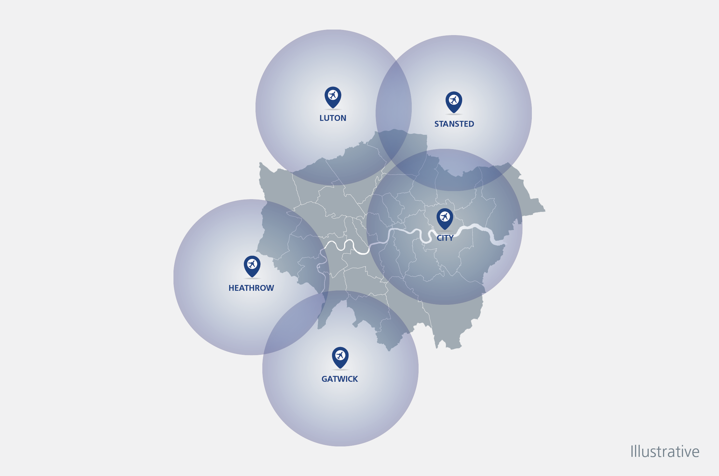
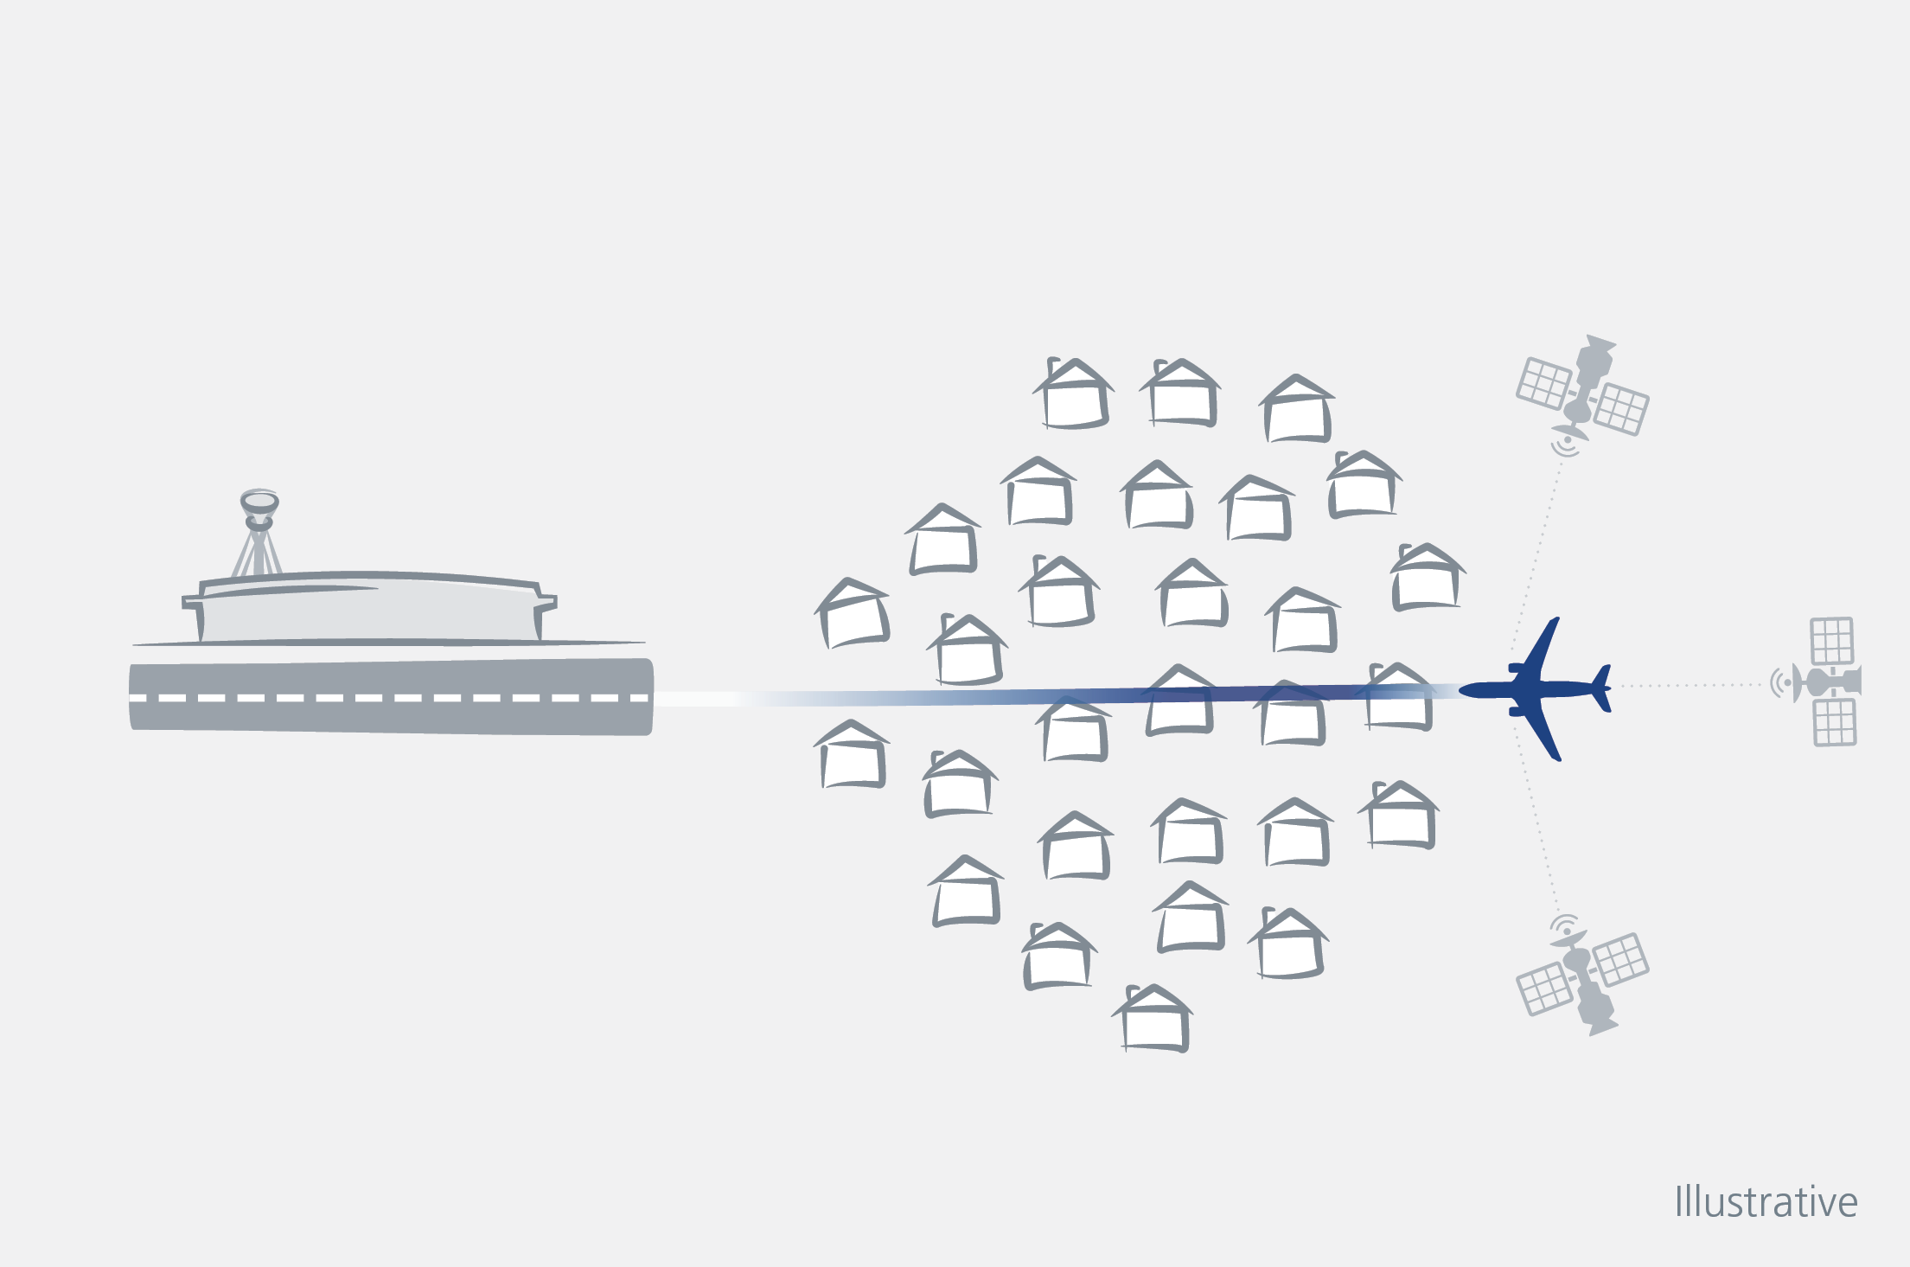
Table Two
Should minimise impact on other airspace users
Minimise dependencies on other airspace users, including neighbouring airports, and consider opportunities to give away airspace that is not required for future operations
Should facilitate design using modern navigational technology
RAF Northolt would base the airspace design on the latest navigation technology, requiring airfield operators to use the most modern technologies.

Slide 4
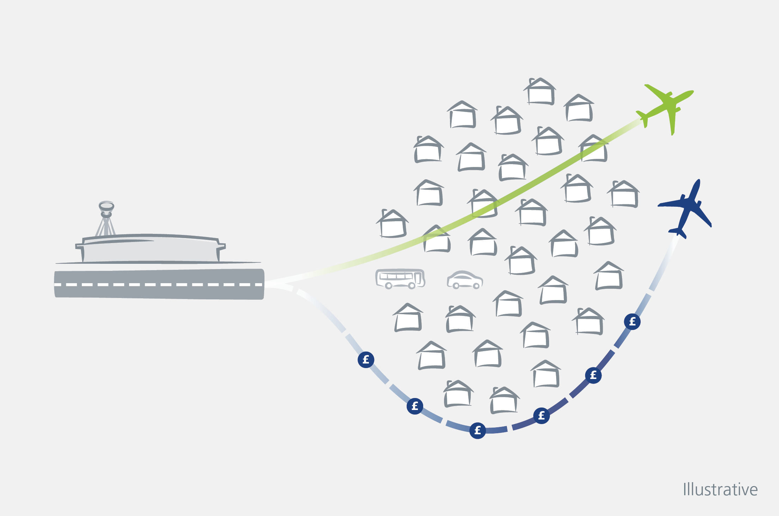
Should facilitate operational efficiencies to maximise benefits to all stakeholders
Flight paths that minimise the workload of pilots and air traffic control, as well as design more efficient routes
Should minimise fuel and greenhouse gases (for civil operations)
Seek to minimise the amount of fuel and CO2 emissions produced. Consideration of short, direct flight paths

Slide 5
Should minimise the impact of aircraft noise
Comply with government regulation and policy on noise impact. Aim to reduce effects on health and quality of life by considering local circumstances

Slide 6
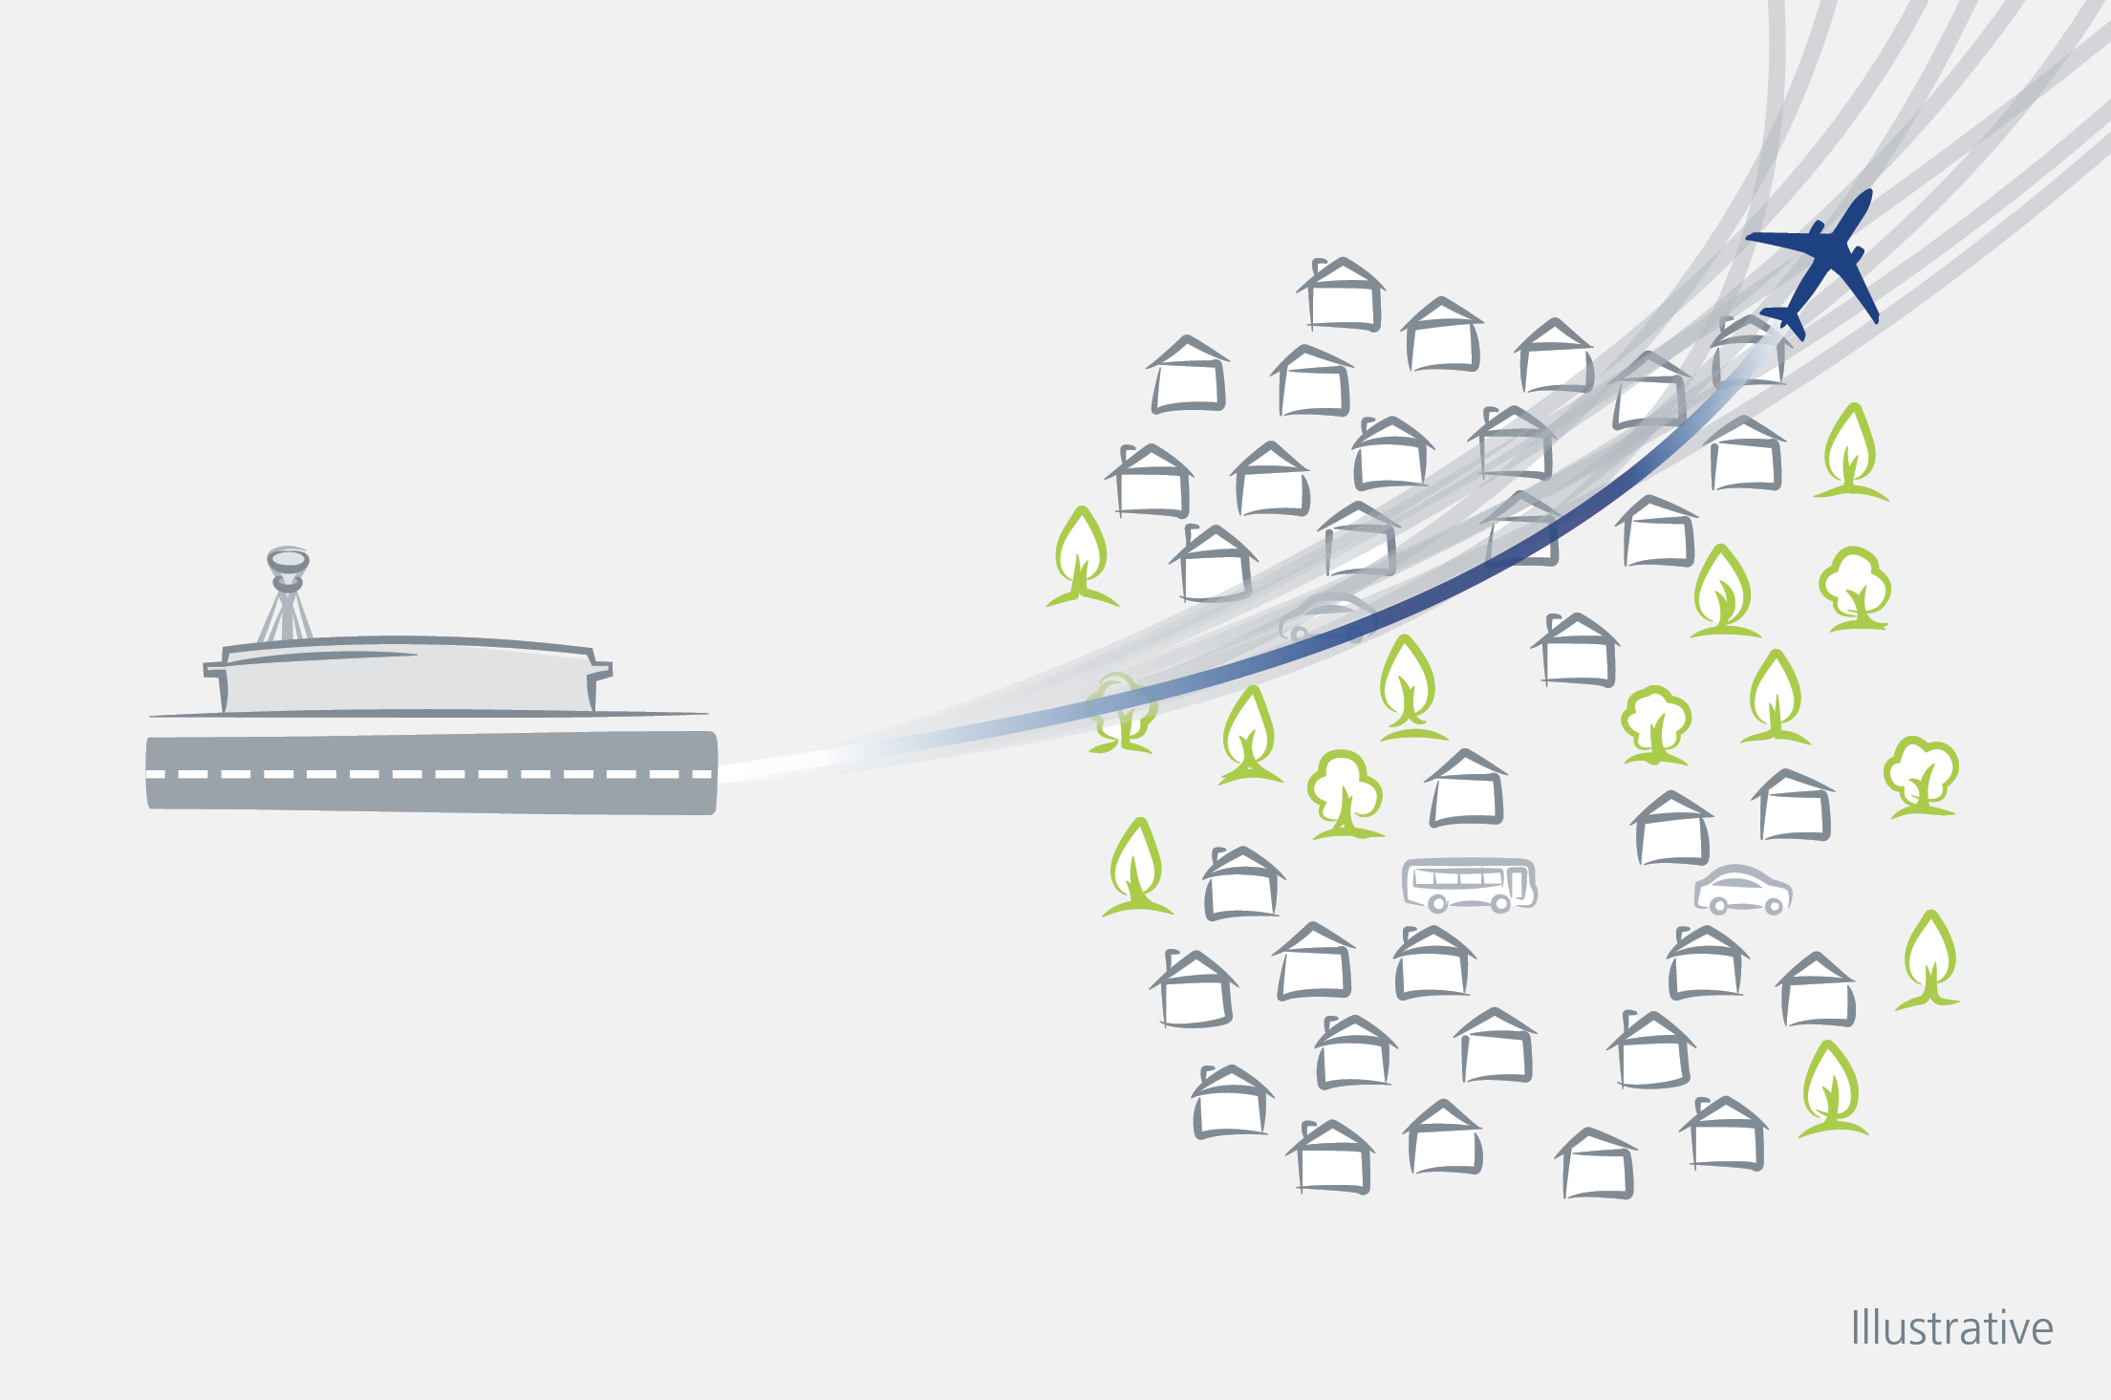
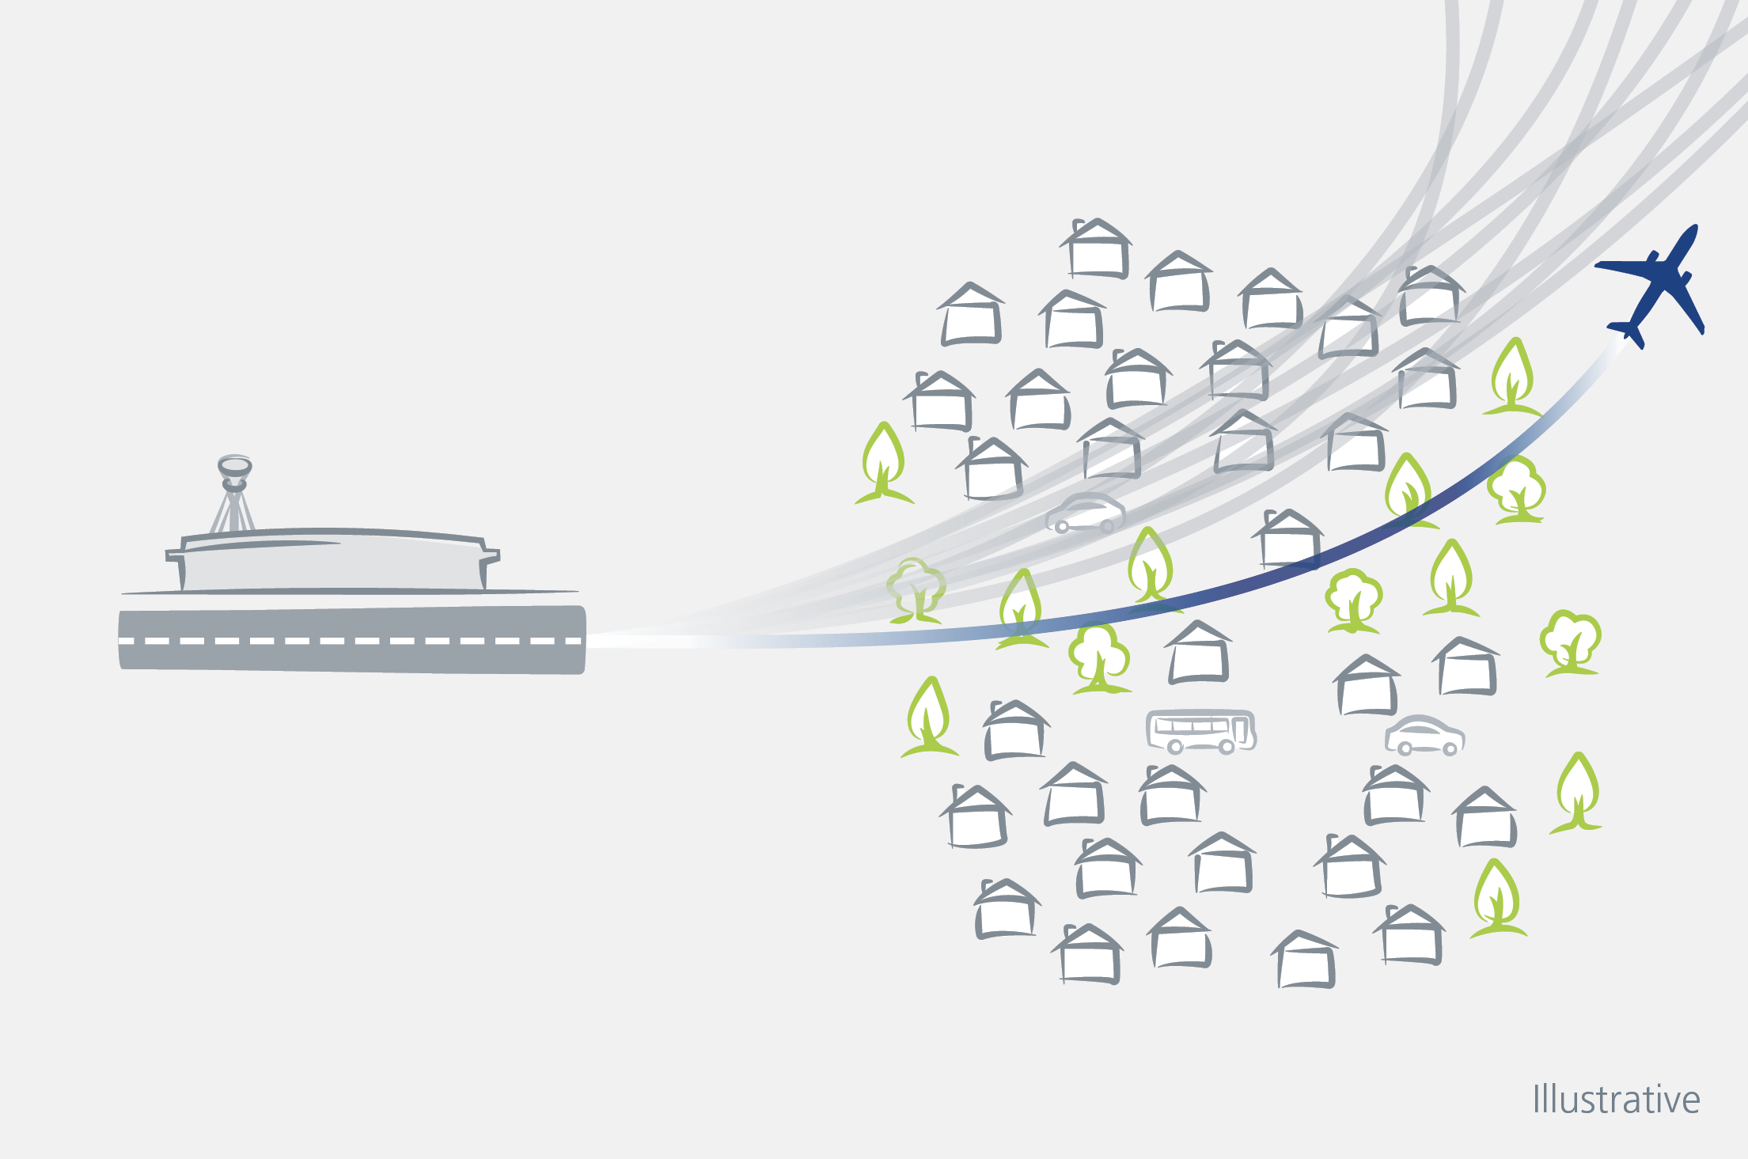
Table Three
Minimise the number of people newly overflown
Where possible, RAF Northolt would limit putting in new routes over those who are not currently overflown. This would mean keeping routes as close to today’s flight paths as possible. However, new routes will have to be created due to the expansion of Heathrow.
8
Minimise the total number of people affected by noise
RAF Northolt would aim to reduce the number of people overflown by aircraft. This will mean fewer people overflown but each of those communities that is overflown would be more affected. This will also lead to planes concentrated over a smaller number of routes.
5

Slide 7
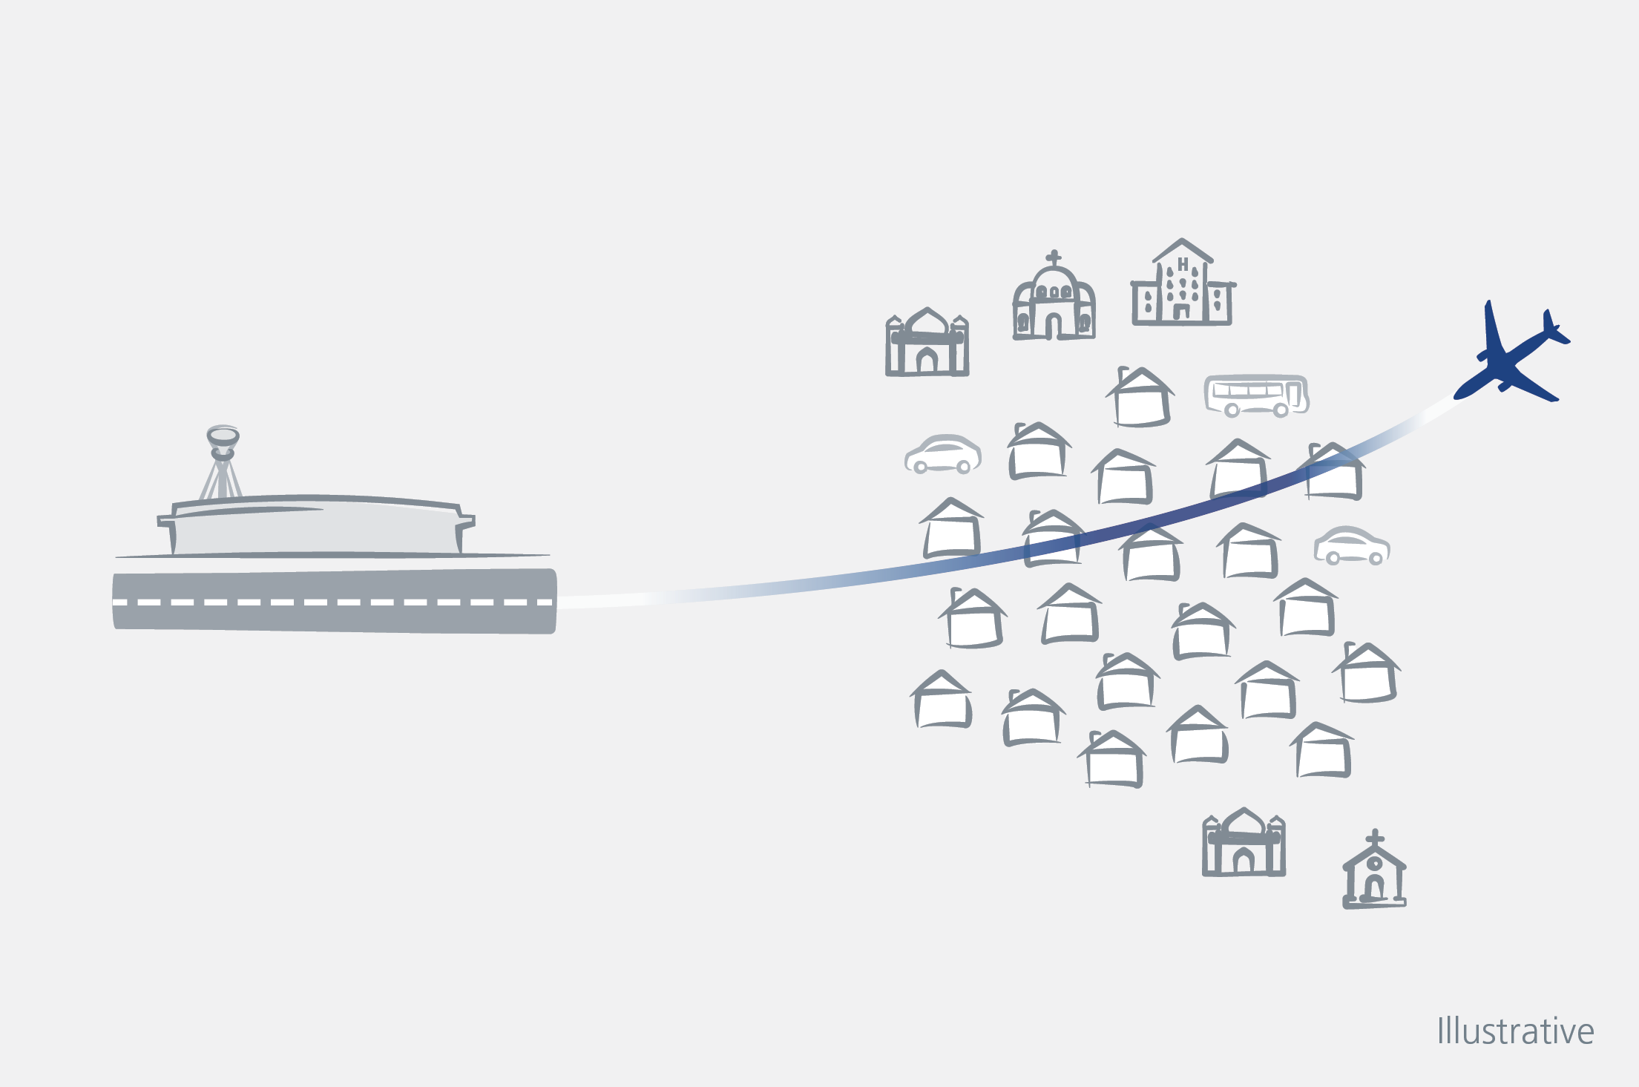
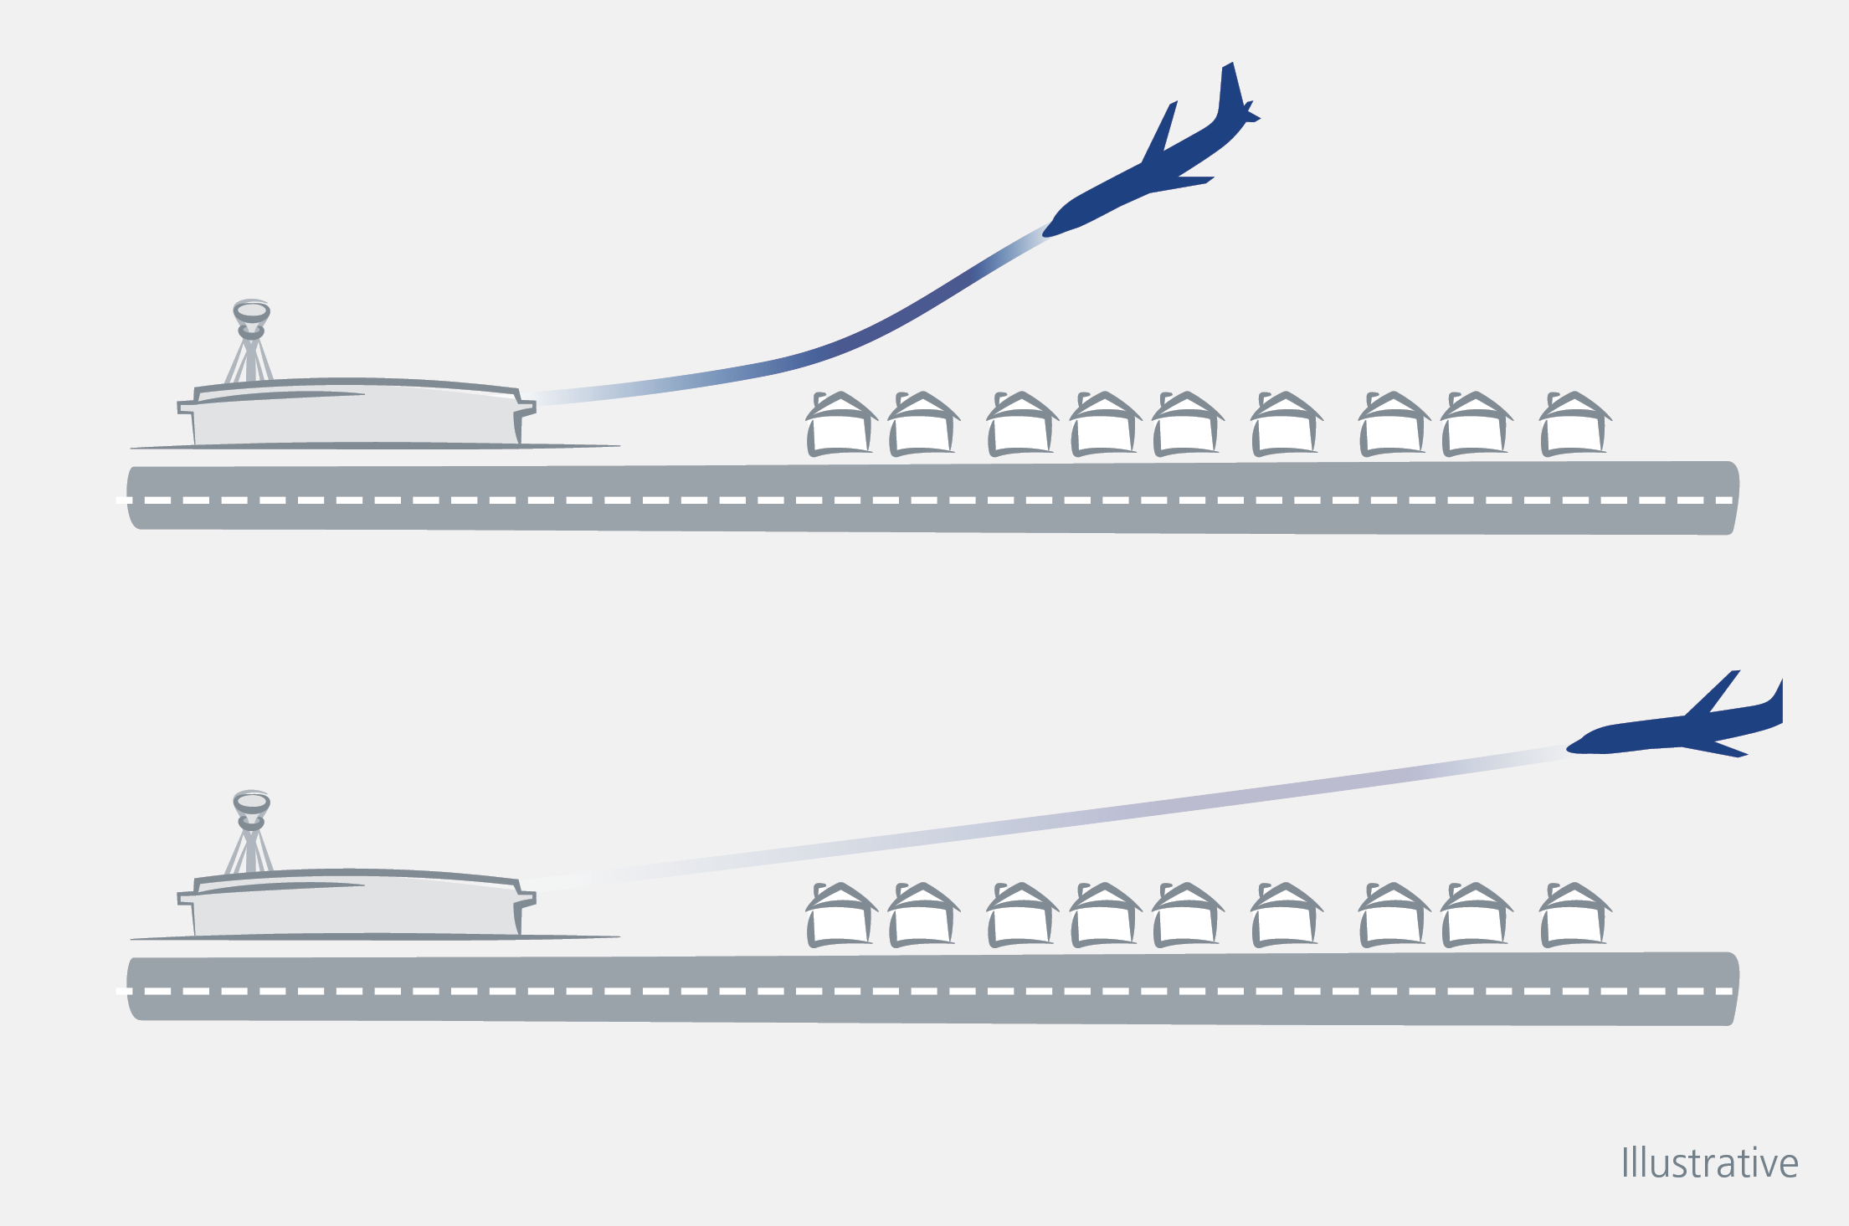
Consider fewer people affected, but more noise
A steeper climb gradient would result in a potential increase in noise, but over a smaller area
Consider more people affected, but less noise
A shallower climb gradient would result in potential reduction in noise, but over a larger area

Slide 8
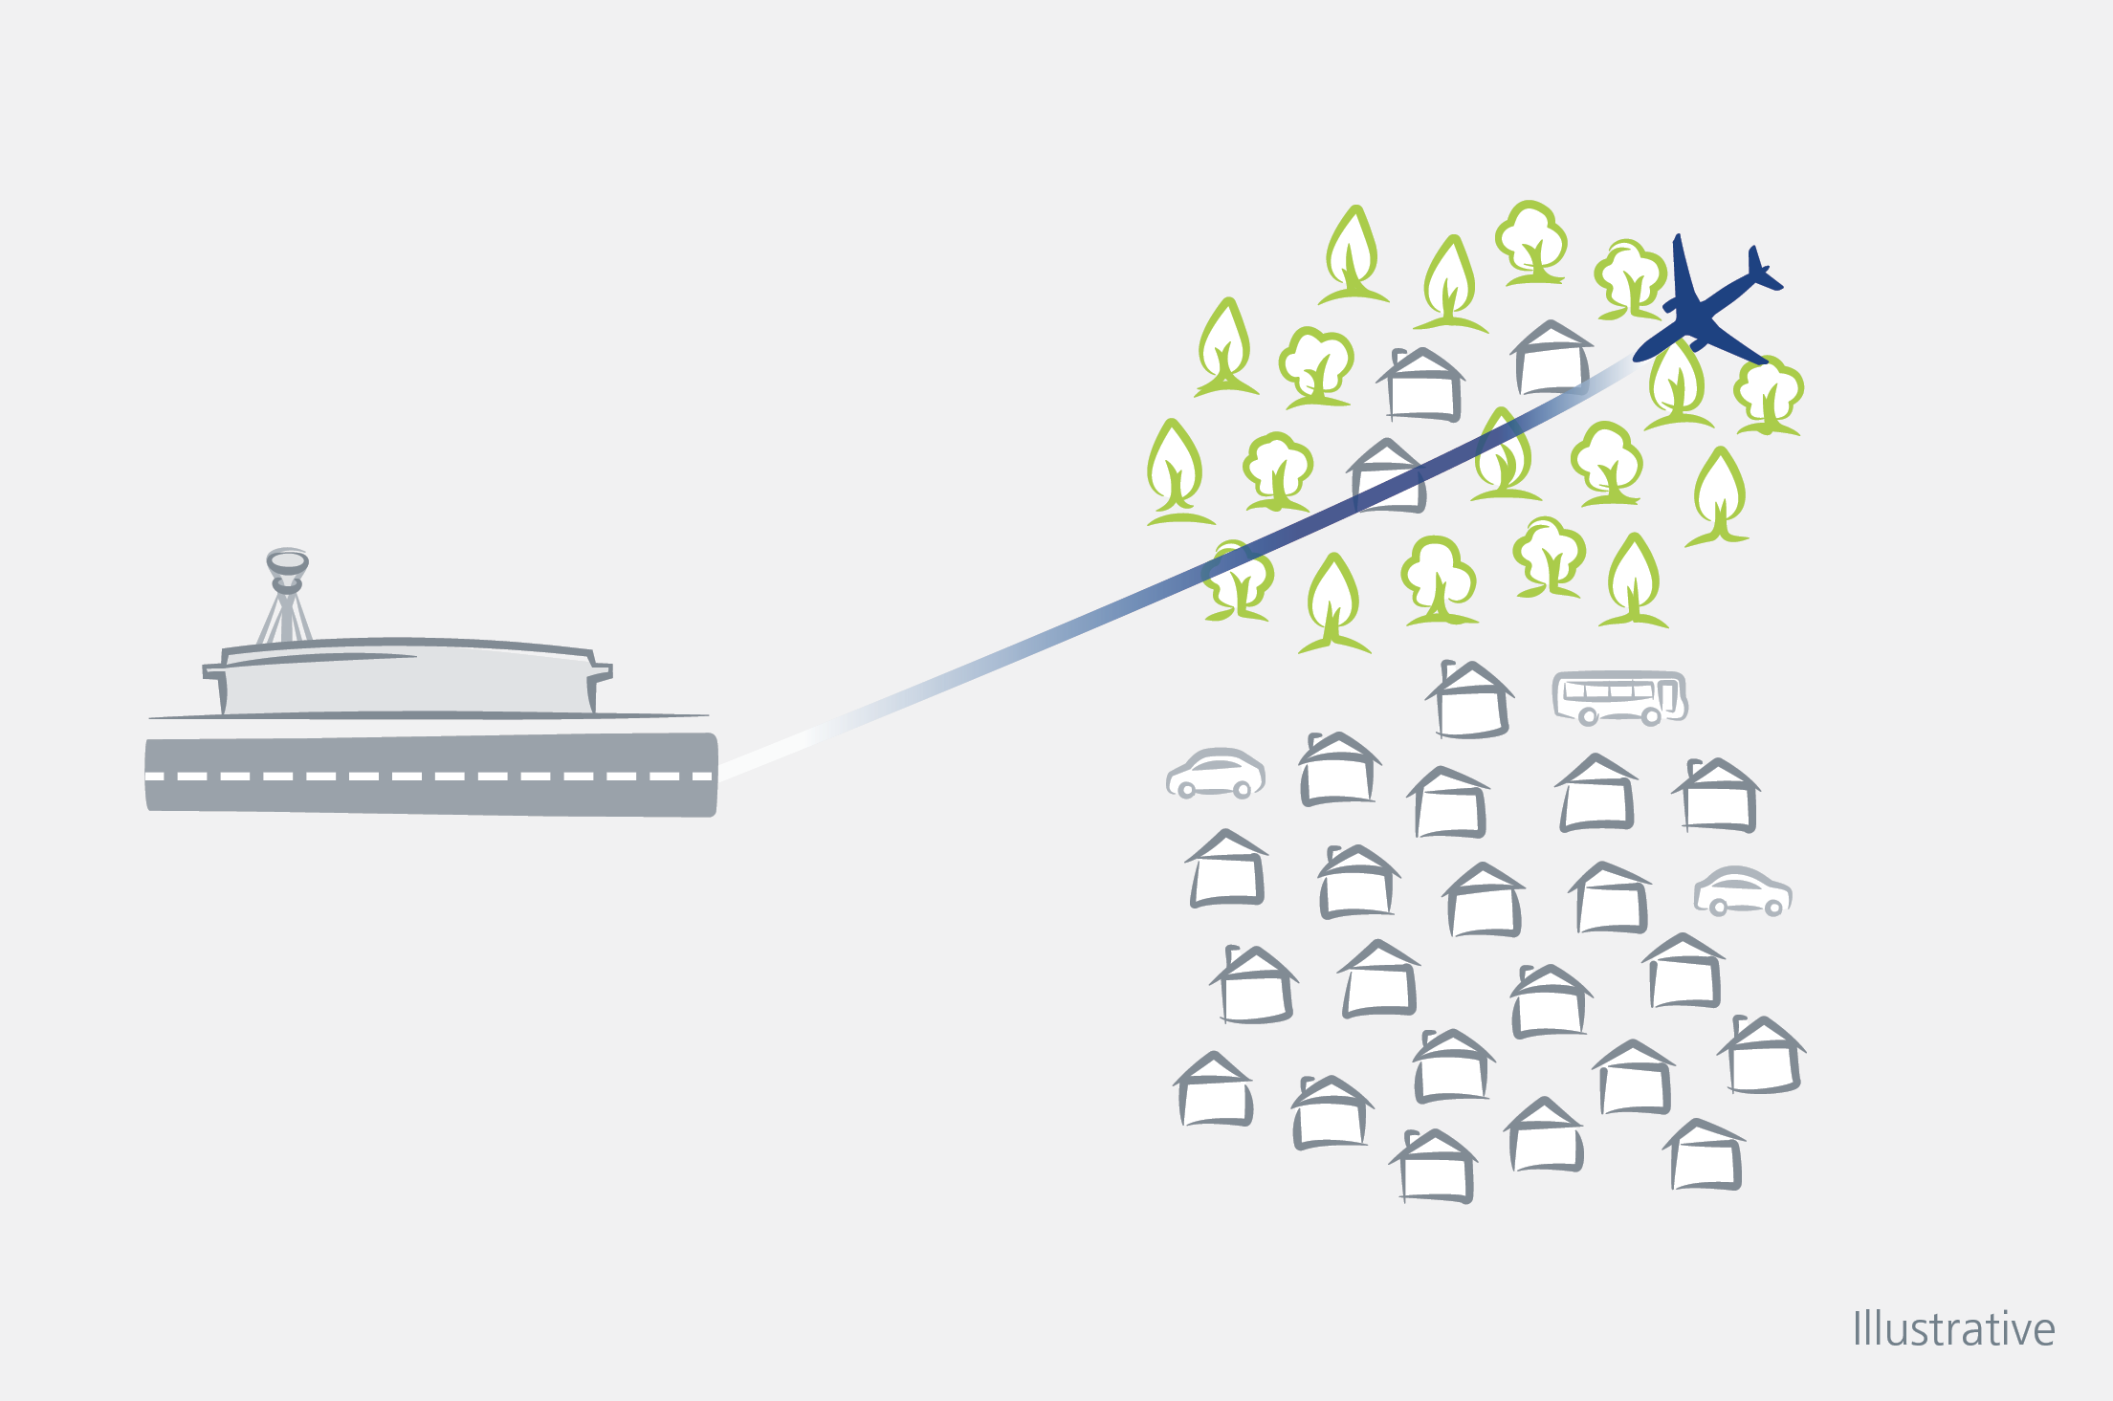
Prioritise flight paths over rural areas, rather than over urban areas
RAF Northolt would aim to put planes over rural areas rather than urban areas, as they are less populated.

